Slide 1
Insurance report group-2
Dhiraj Harjeevan Pardeshi
R Naga Sujeet
Annkit Bhoi
Tanmay Prakash Paye​​

Slide 2

About Us
The insurance report provides a comprehensive overview of key performance indicators related to cross-sell,renewell,new, achievements, target attainment, invoice collection, and the activities of account executives categorized by income class. It includes a breakdown of product distribution based on employees' names and tracks the number of meetings conducted. The report also highlights open opportunities, total opportunities, and revenue generated from the top four opportunities. This data offers valuable insights into the company's sales and revenue performance, allowing for strategic analysis and decision-making.

Slide 3
contents
KPI
DASHBOARD
Clearly defined and specific to a particular aspect of the Insurance report.
Answers the question: What needs to be accomplished?
EXCEL DASHBOARD
TABLEAUE DASHBOARD
POWER BI DASHBOARD
SQL
PROJECT OVERVIEW
SQL queries
Output of the insurance report
analysis

Slide 4
Branch Dashboard
Branch dashboard to discuss New and renewal business number with each branch. This dashboard will be discussed between Corporate team and Individual branch heads.
Individual performance within the branch:
Target FY from Individual target sheet (New, Cross sell and Renewal) Fields to be referred (Column C, E, F and G)
Placed Achievement form Brokerage + Fees sheet (New, Cross sell and Renewal) (Brokerage sheet: Column G, J, M, K, L) (Fees Sheet: B, D, E, F, G)
Invoiced Achievement from Invoice sheet (New, Cross sell and Renewal) Column (B, F, G, J)
Percentage of Achievement for Placed and Invoice – (Achieved/budget)
No of meetings for current year – Meeting sheet (A, C, D)
Open Oppty – Opportunity report (Column: C, E, F, G) (Stage ‘Open’ Column G = Propose Solution & Qualify Opportunity)
Closed Won – Opportunity report (Column: C, E, F, G) (Stage ‘Won’ Column G = Won)
Conversion Ratio (Closed Won/Total Opportunity)
Further drill down to individual level top 10 open oppty and Win
KPI List
1-No of Invoice by Accnt Exec
2-Yearly Meeting Count
3.1Cross Sell--Target,Achive,new
3.1New-Target,Achive,new
3.1Renewal-Target, Achive,new
4. Stage Funnel by Revenue
5. No of meeting By Account Exe
6-Top Open Opportunity

Slide 5
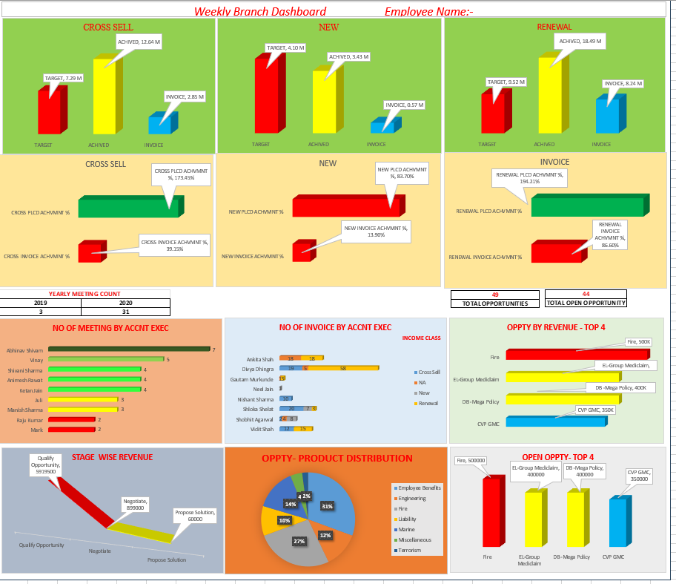
EXCEL DASHBOARD

Slide 6
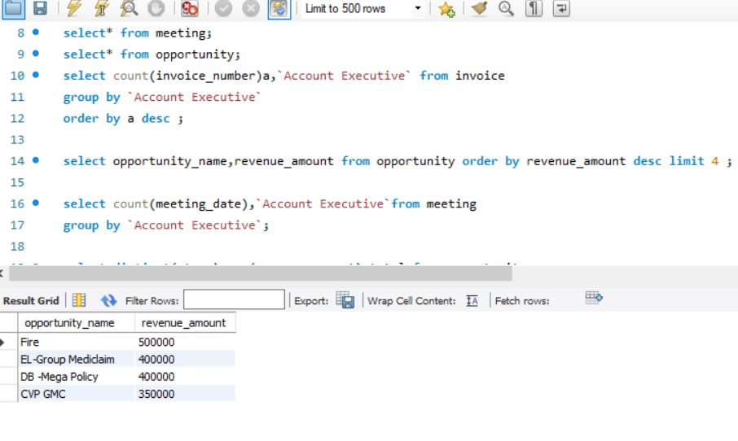
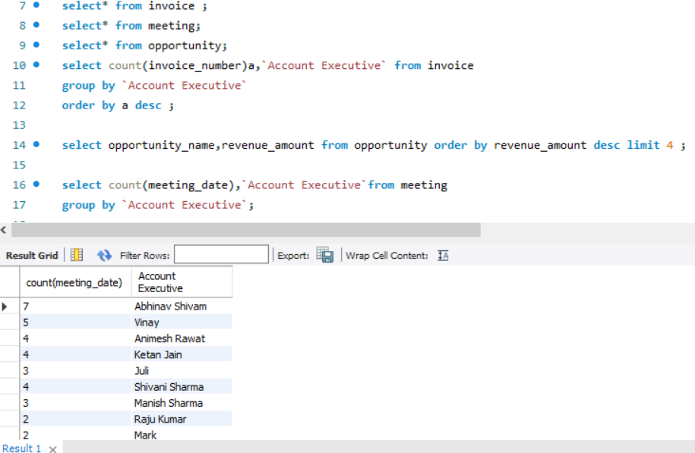
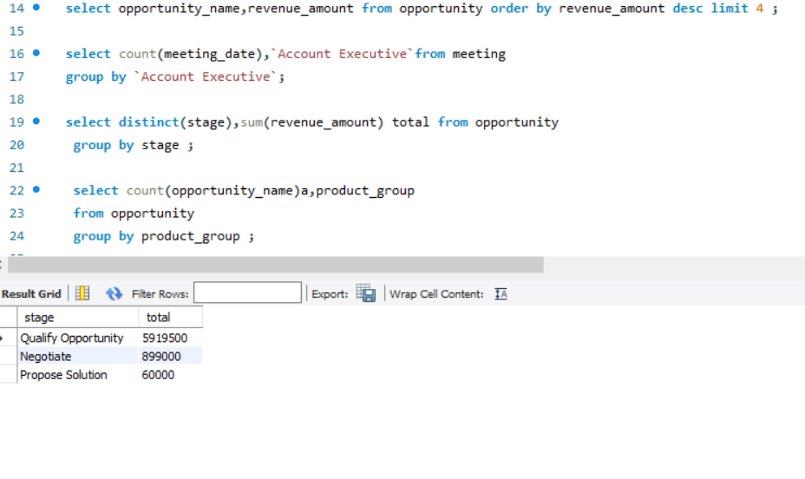
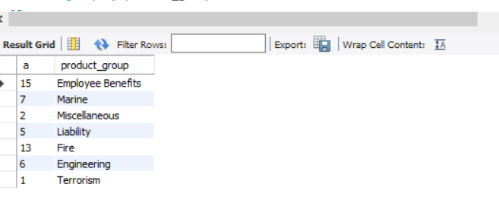
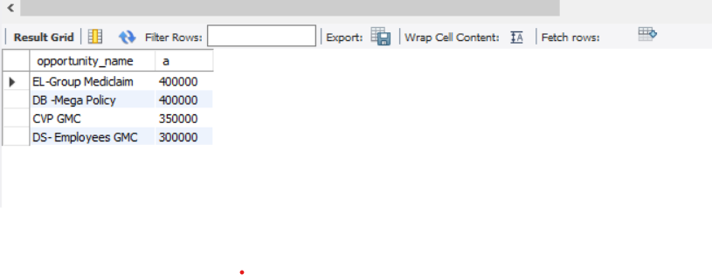
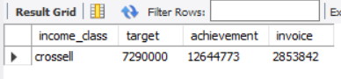
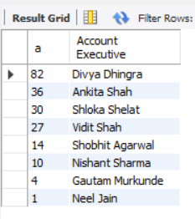
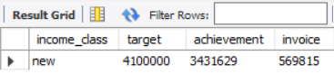
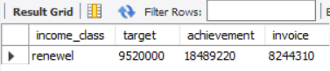
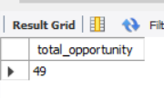
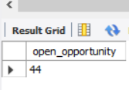
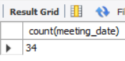
SQL QURIES

Slide 7
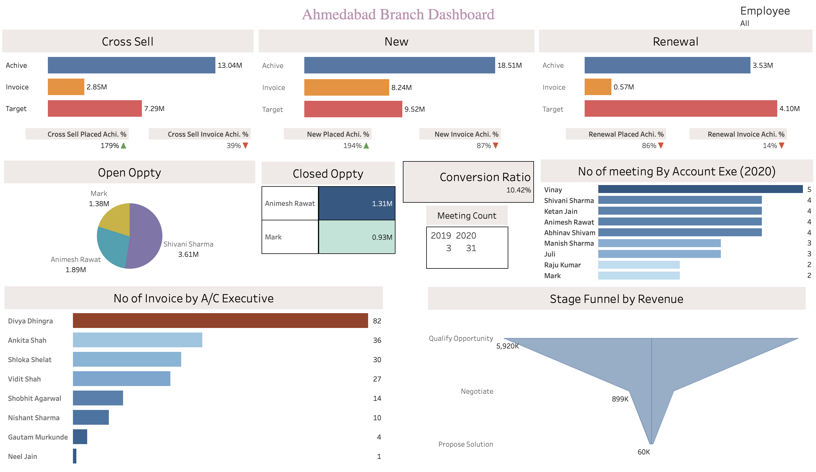
Tableau Dashboard

Slide 8
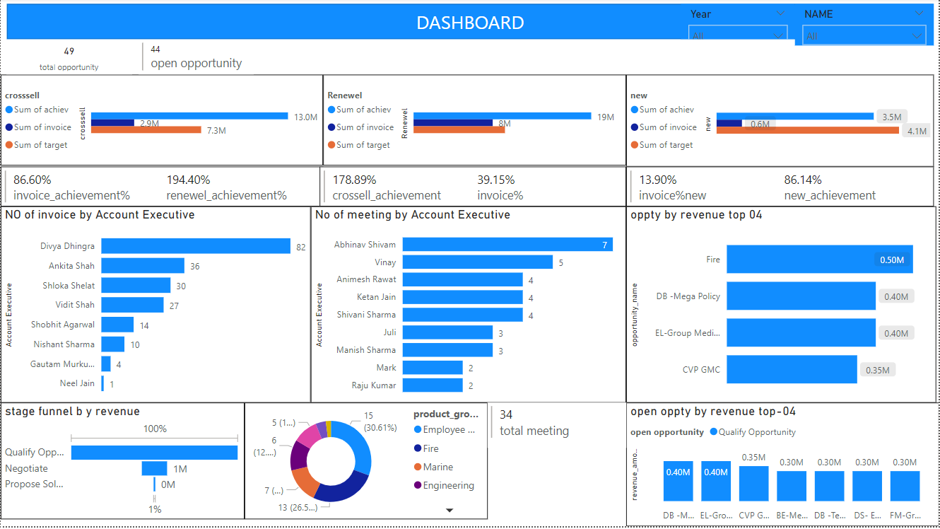
Power BI Dashboard

Slide 9
Project Overview
The insurance report aims to provide a comprehensive analysis of various key performance indicators (KPIs) and strategic aspects related to the organization's sales and revenue generation. The project covers a specified period and focuses on evaluating the effectiveness of cross-selling strategies, target achievement, invoice collection efficiency, account executive performance, income class segmentation, product distribution, and opportunities within the sales pipeline.

Slide 10
Output: The output of this project is a detailed and insightful report that offers valuable information for decision-makers within the organization. The report includes:
Cross-Sell ,New,Renewel Achievement Overview:
Clear insights into the success of cross-selling, new, renewel efforts, showcasing the organization's ability to promote additional insurance products to existing clients.
Target Analysis:
Detailed analysis of achieved targets, providing a clear understanding of the alignment between set goals and actual performance in cross-selling.
Invoice Collection Efficiency:
Insights into the efficiency of the invoice collection process, highlighting success rates and areas for improvement to maintain financial stability and client satisfaction.

Slide 11
Account Executive Metrics:
Evaluation of account executive performance based on the number of conducted meetings, serving as a key indicator of proactive client engagement and overall sales team effectiveness.
Income Class Segmentation:
Breakdown of meetings by account executives according to income classes, providing insights into engagement levels across different client segments for targeted strategies.
Product Distribution Analysis:
In-depth analysis of product distribution, illustrating the correlation between employee efforts and the types of insurance products sold to align offerings with client needs.

Slide 12
Opportunity Landscape:
Overview of open opportunities, indicating areas for future growth and potential untapped areas that require strategic attention.
Total Opportunities Assessment:
Holistic view of the organization's sales landscape, encompassing both open and closed opportunities, contributing to an assessment of the overall health of the sales pipeline.
Top 4 Opportunities Revenue Breakdown:
Elaboration on the revenue generated from the top four opportunities, enabling a focused understanding of high-impact deals and identification of areas for further growth.

Slide 13
Thank you

